Slide 1
Software Engineering Project
Lauren Pennell
Steven Bradford
Miguel Reyes

Slide 2
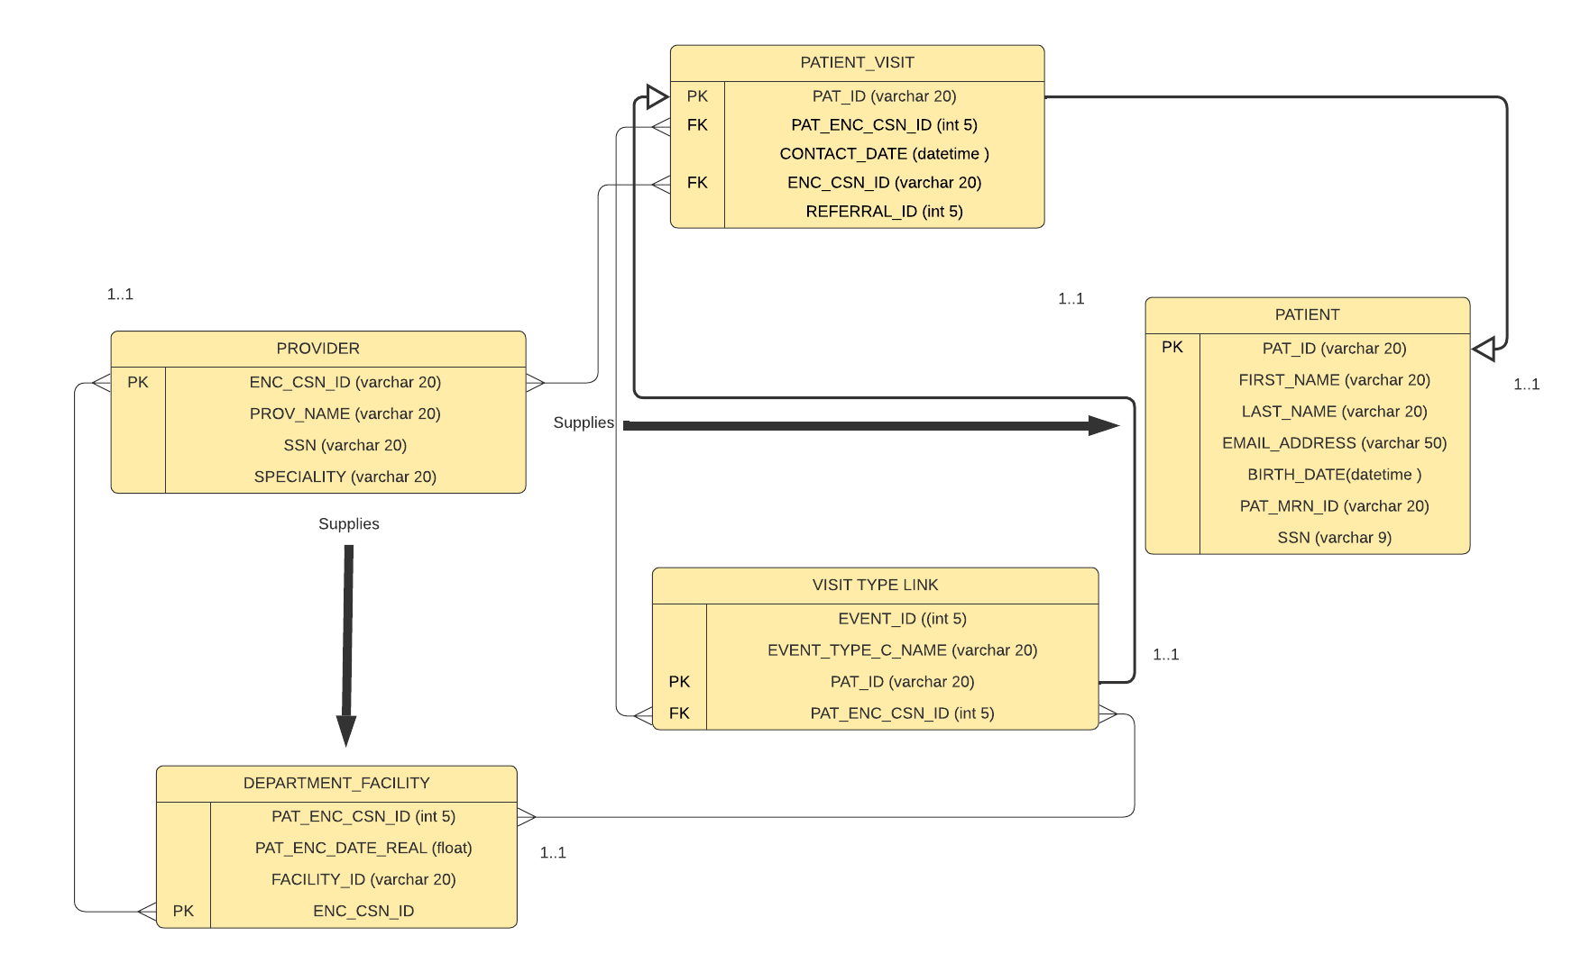
Storage new data

Slide 3
Patient Visit
This is the main table.
We have a link with the other 4 tables.
Help us to make an easier link with the Hospital’s current data.
This table summarizes all the information that we collect from our scanning code

Slide 4
Patient
Create
Create a unique Patient.
Assign
Assign the PAT_ID.
Place
Place where we store the Patient information

Slide 5
Visit Type Link
Create event Id.
Identify purpose of visit.
Link with Patiend ID.
Link with Provider.

Slide 6
Provider
Provider Name.
Assign a unique number.
Specialty.

Slide 7
Department Facility
Assign Facility Number
Track the date of the appointment
Link with the Provider.

